Slide 1
The development of pension funds’ net assets

Slide 2
According to the pension providers, the amount of assets as per 31st March 2025 was approximately 270 billion euro. The amount presented here differs about billion from the total in the interim reports. This is caused by inaccuracies within the statistical process.

Slide 3
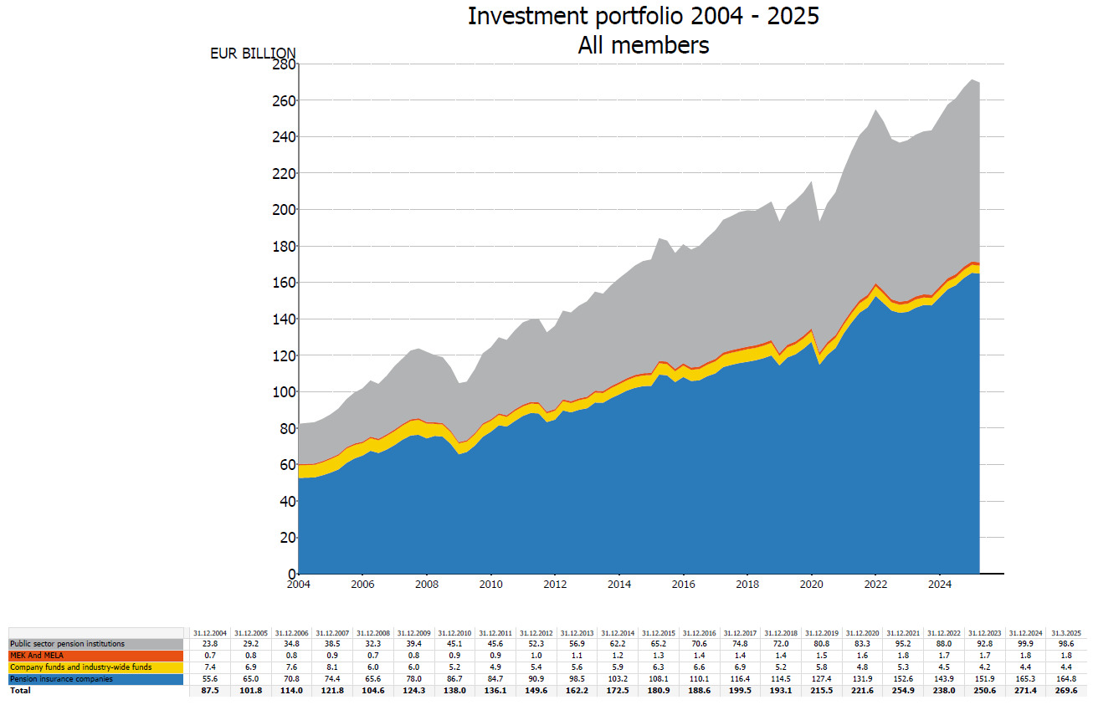

Slide 4
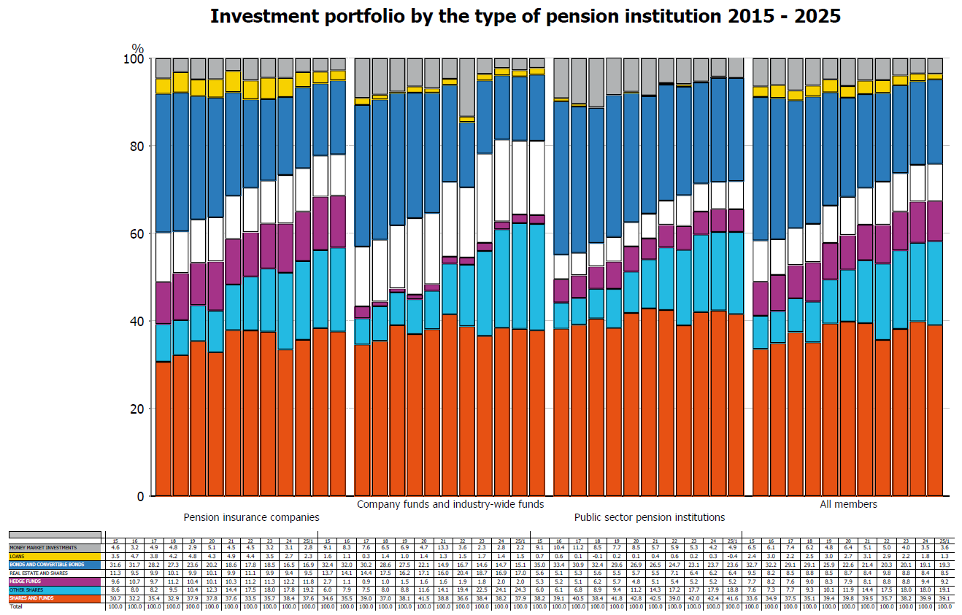

Slide 5
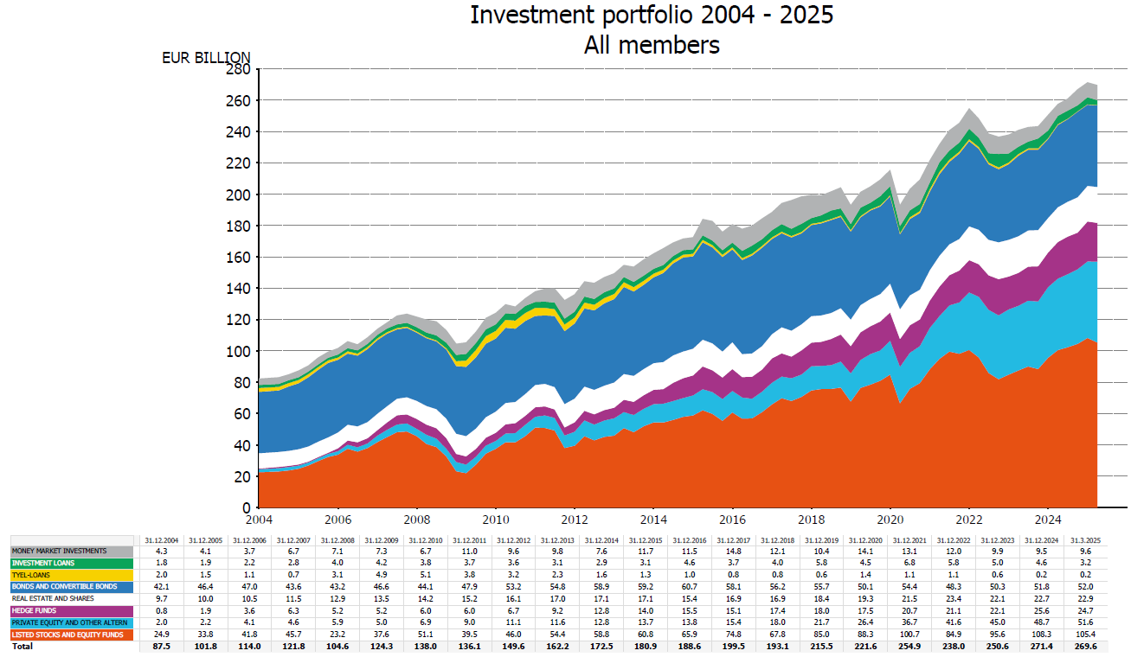

Slide 6
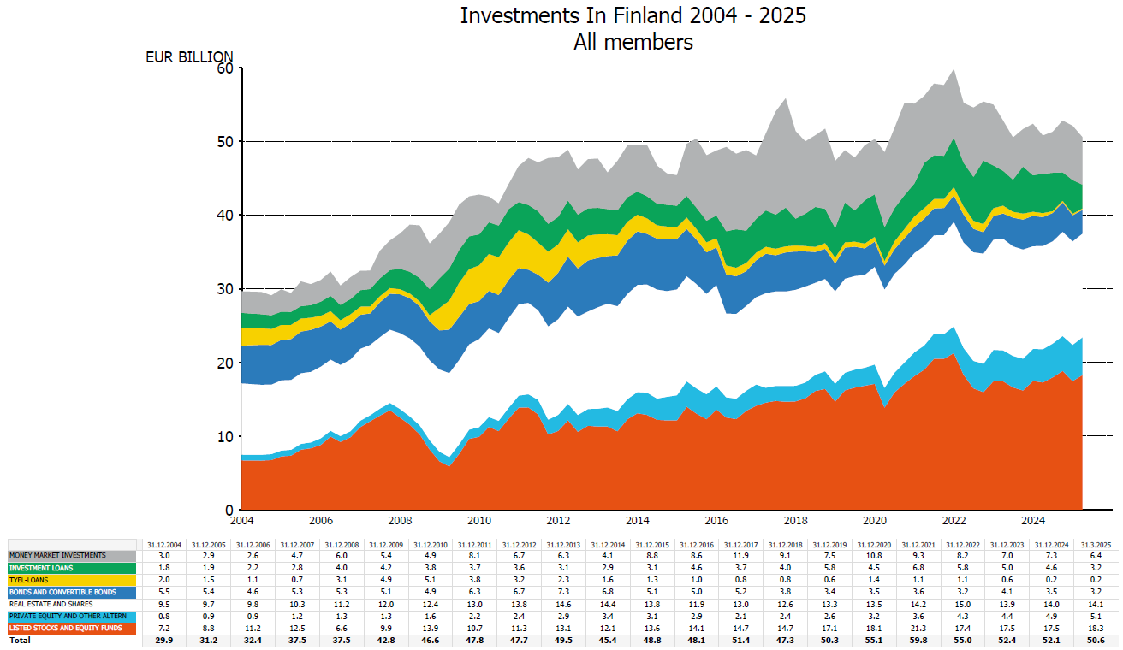

Slide 7
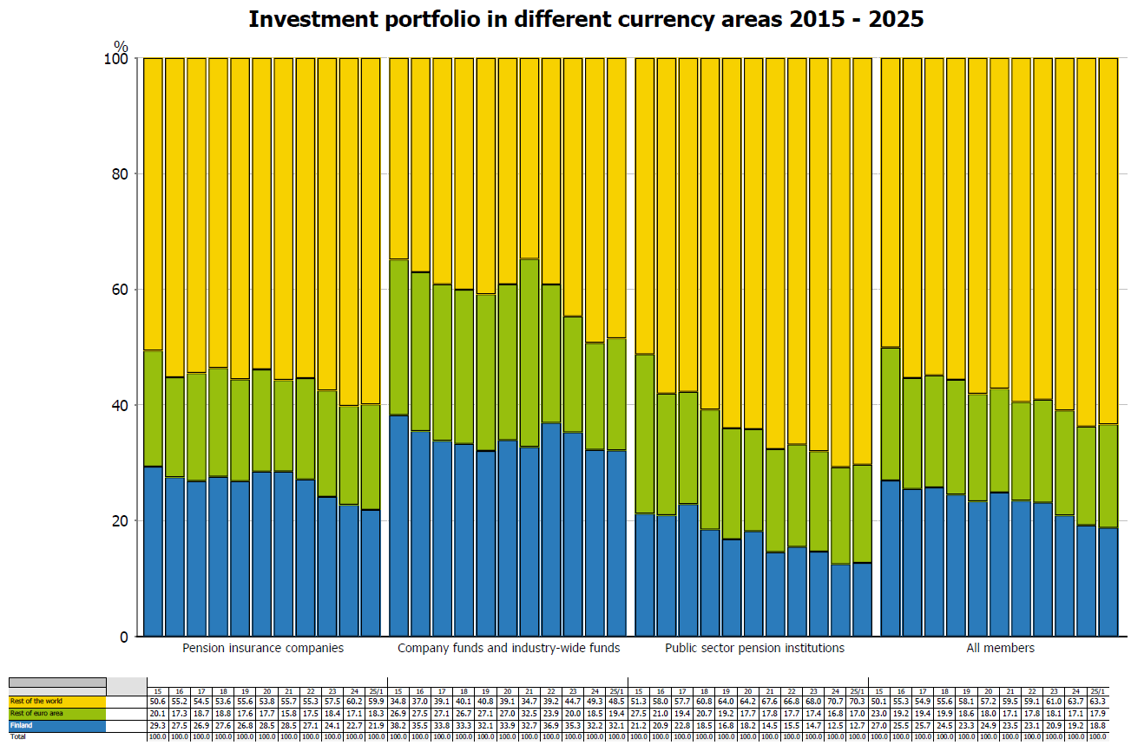

Slide 8
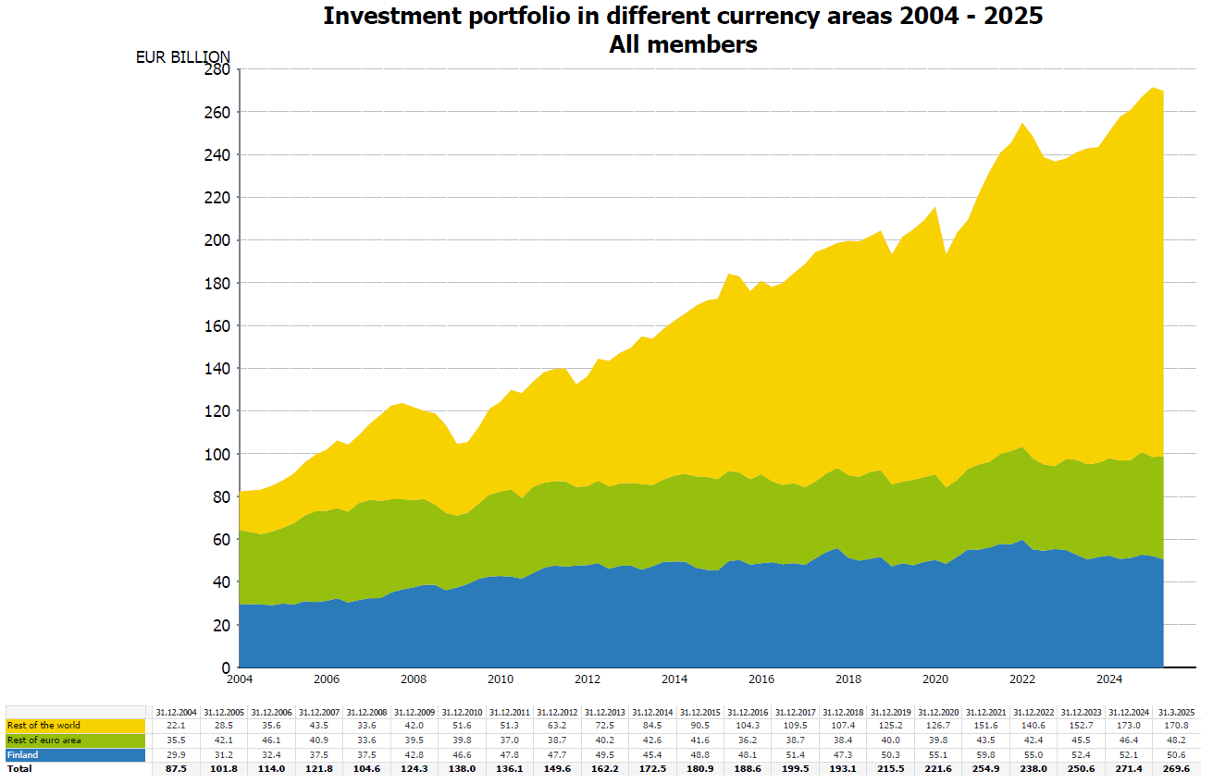

Slide 9
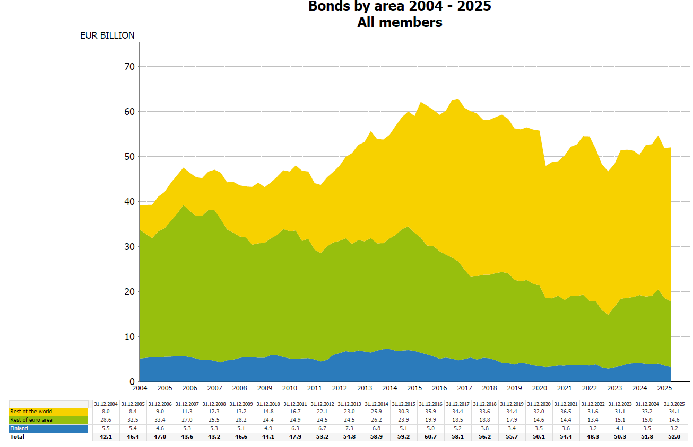

Slide 10
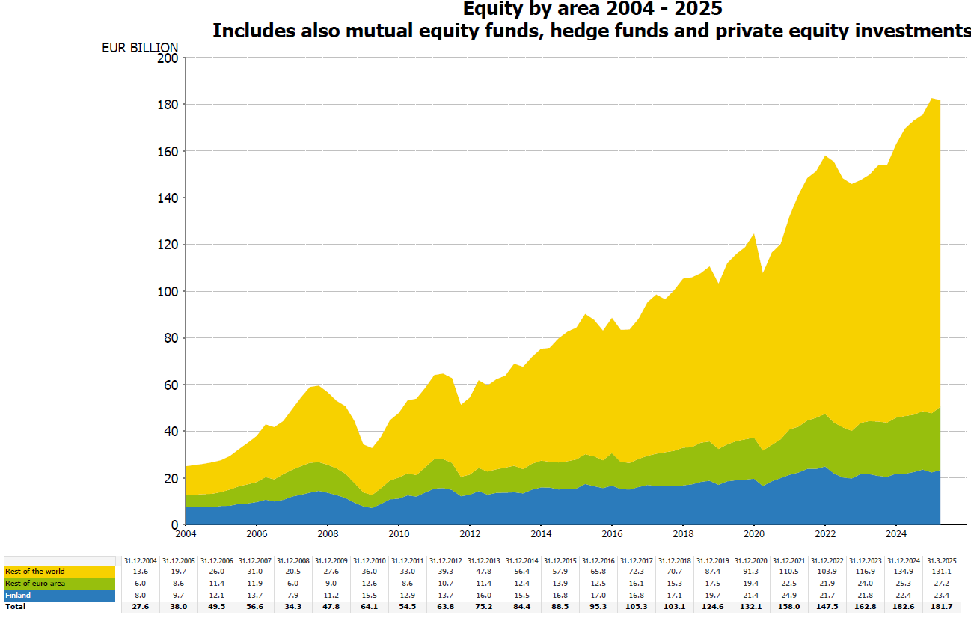

Slide 11
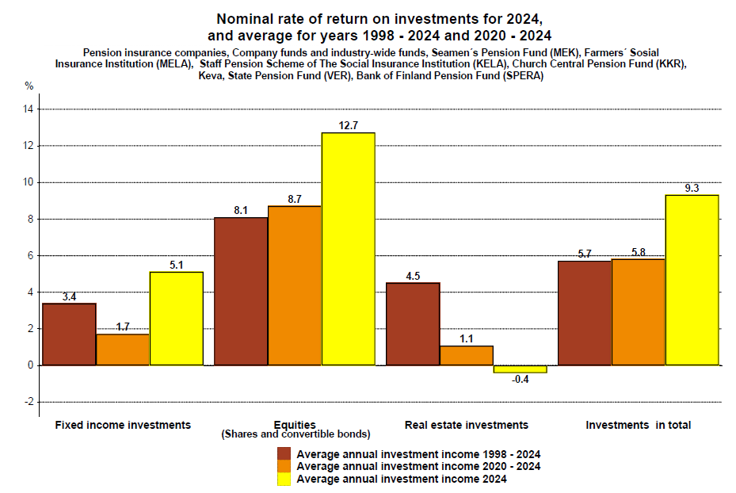

Slide 12
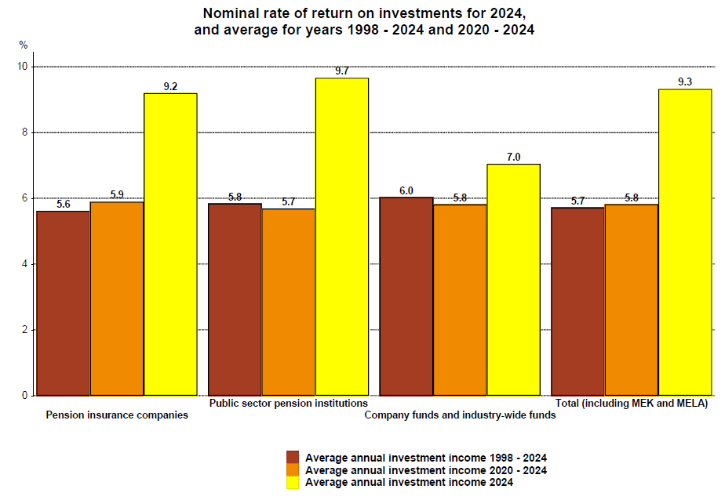

Slide 13
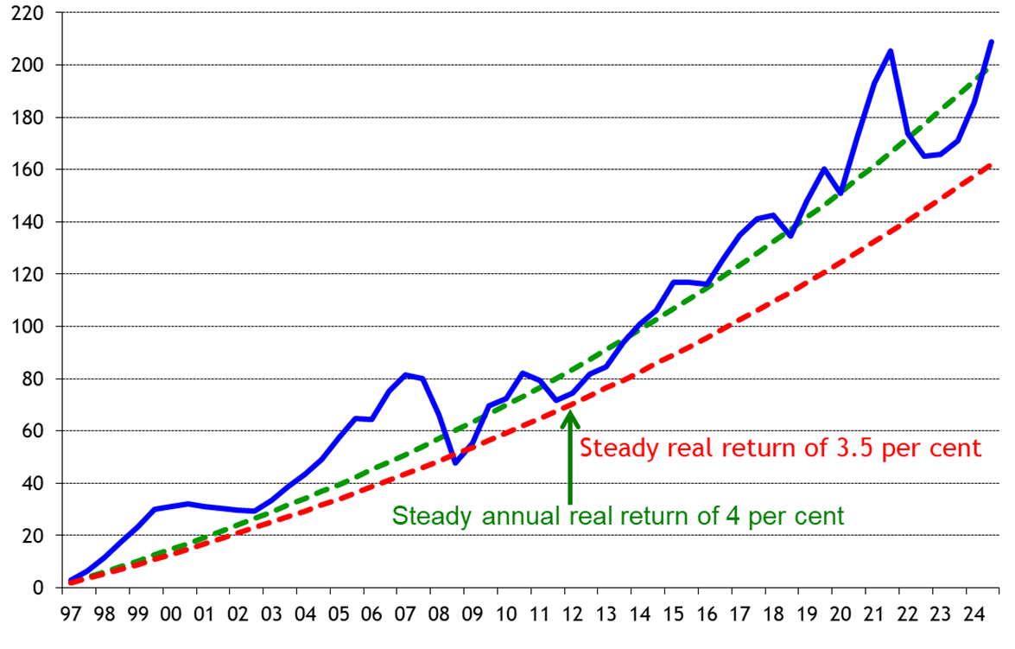
Real return accumulated on investments by private-sector pension providers in 1997-2024, percentage of capital employed

Slide 14
The impacts of the new data collection model for investment statistics
In the reporting adopted in 2016, some fund units previously classified as equity fund investments have now been classified as units in hybrid funds. For instance, cash collateral given and received in connection with derivatives, and purchase price claims and liabilities associated with investments, were reported in more detail than before.
In the new data collection model for earnings-related pension assets devised by Statistics Finland, data are collected on both external and internal lending done by a group of companies. Internal lending comprises all lending to the pension insurer’s own companies, including its own real estate companies Thus, the statistical report does not specify directly how much of the lending goes to the pension insurer’s own real estate companies. Alongside the new reporting, all lending, whether internal or external, is included in investment loans. In consequence, the amount of real estate investments has decreased but, on the other hand, the amount of investment loans has increased by the same sum. This change in classification therefore has no effect on total investment assets, because one asset type merely transferred from one investment category to another.
In addition, in the reporting adopted in 2016, some fund units previously classified as equity fund investments have now been classified as units in hybrid funds. However, this has no effect on total assets.
The way in which the net value of derivative contracts is reported and handled has also been specified.
Instructions by Statistics Finland for collecting data on earnings-related pension assets http://www.stat.fi/keruu/telq/ohjeet.html

